Slide 1
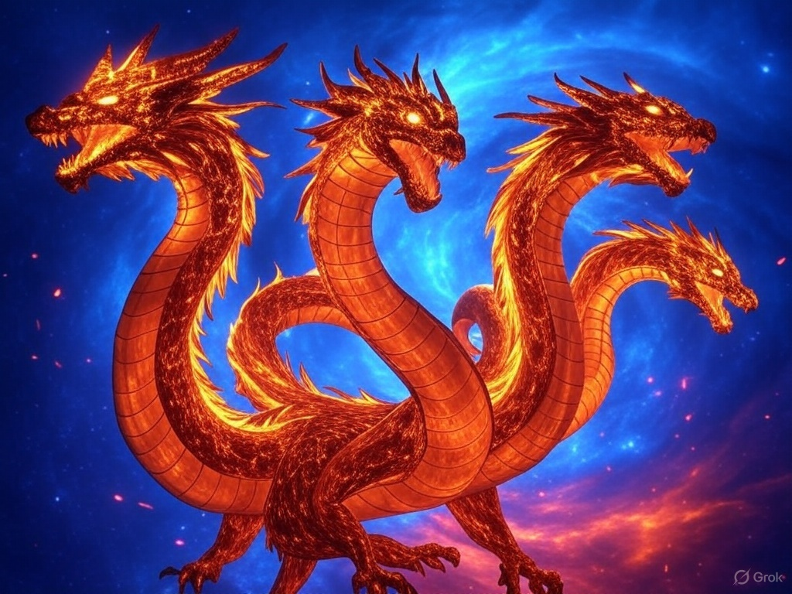
Digital Dragons
digital dragons logo design, more digitalized and anime oriented, with a four-headed dragon resembling fiery serpents in a cosmic storm”—and apply a pixelated effect to it

Slide 2
Dense Passage Retrieval for Open-Domain Question Answering
Ayesha Khatun, Maksin Kulik , Abhay Nandiraju, Matthew Hernandez

Slide 3
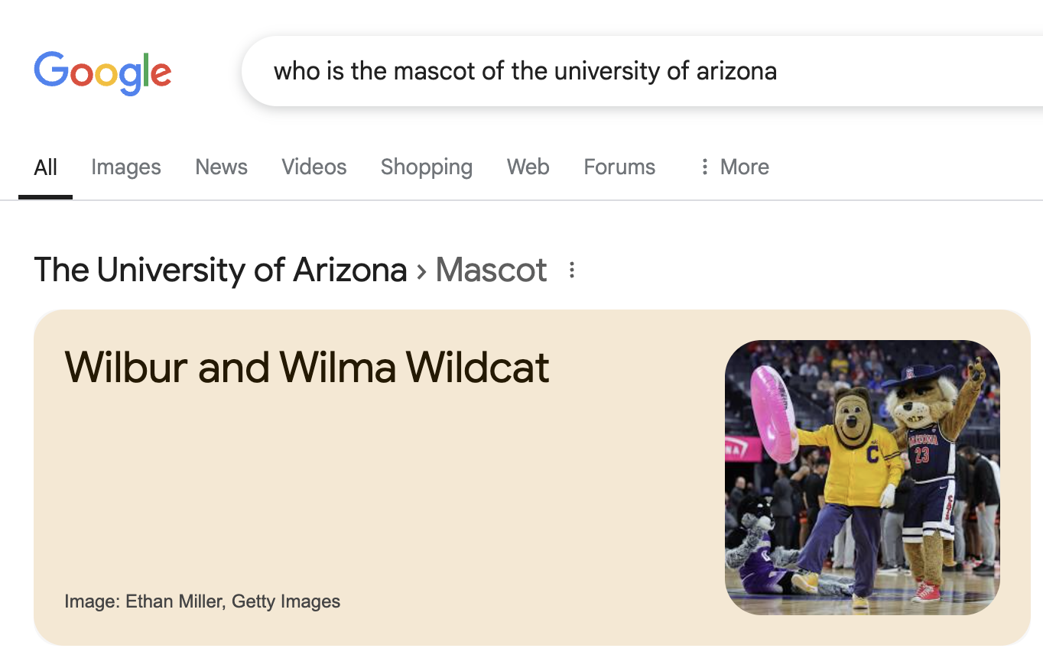
Motivation: Search
Query
Short Answer
Notes:
As a motivation slide, let’s step back to appreciate how we can query a search engine with a question and receive an answer!
Entities & quantities are often answers. Hence the use of NLP preprocessing modules

Slide 4
Introduction
Question answering (QA): answering questions posed in natural language with [short] answers
Open domain: [factoid] questions that can be about any topic—difficult!
Two popular paradigms of QA:
Text-based
Knowledge-based
This presentation!
Notes:
Let’s define some terms…
Introduction to the research problem

Slide 5
Information Retrieval
Methods from information retrieval (i.e., indexing, ranking, vector space model) can be nicely adapted
Needs reformulation: humans instinctively ask questions—we want answers rather than documents
Notes:
Point 2 refers back to the motivation slide—this is a user need.

Slide 6
Outline for (mostly factoid) QA
QUESTION PROCESSING
Set of heuristics (e.g., question parsing, extract entities, choose answer type, question classification)
Formulate queries for retrieval—boolean retrieval model
DOCUMENT & PASSAGE RETRIEVAL
Collection of ranked documents are returned using IR methods
Documents are processed further into passages and reranked
ANSWER PROCESSING
Extracts potential answers based on NLP techniques
Ranks answers on another set of heuristics
Notes:
Three main points; each can be handled explicitly or implicitly.
Subpoints aren’t important for presentation. Red text is important.

Slide 7
Brief history
The TREC (Text REtrieval Conference) first included the QA track in 1999
Constrained to factoid questions to make task amenable to evaluation¹
IBM Watson (Ferrucci et al. 2010) is a hybrid-model applied to the Jeopardy! Challenge
DrQA (Chen et al., 2017) is a neural machine reading system applied to open-domain QA—simple framework suggested
ORQA (Lee et al., 2019) proposed an unsupervised objective—dense retriever used
Assumption: successful evaluation must be difficult enough for current technology
Notes:
Just history. Interesting note is footnote 1.
Open domain is difficult. Can’t be too difficult or too easy.

Slide 8
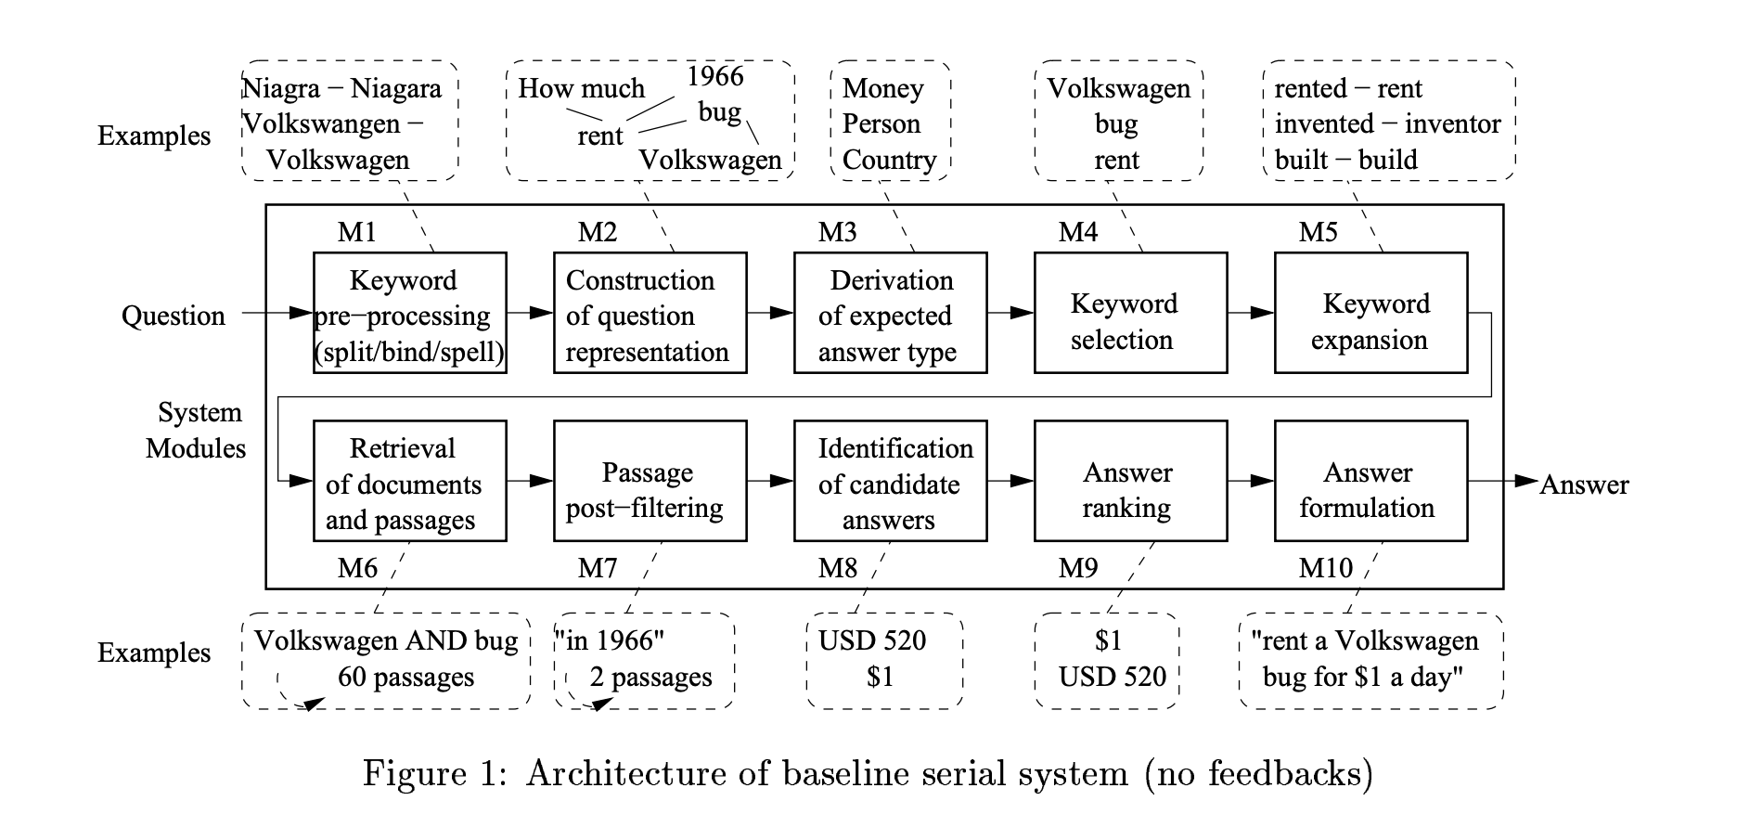
Example of an early system
Moldovan et al. (2003)
What problems do you see with system?
Notes:
This is an example of an early system. Do you notice any problems? A: Over 10 modules! A

Slide 9
Problems
Serial system
Potential for cascading errors which requires in-depth error analysis
Implies more debugging and potential to be outdated quickly—precludes short development cycle
Still successful ~ 70% on QA datasets
It would be nice for a simplified framework to handle QA outline
Notes:
Serial system definition: assembly lines or transfer lines. In assembly lines, a base, or partial assembly of the product travels to each station on a conveyor. The product is held stationary at this point.

Slide 10
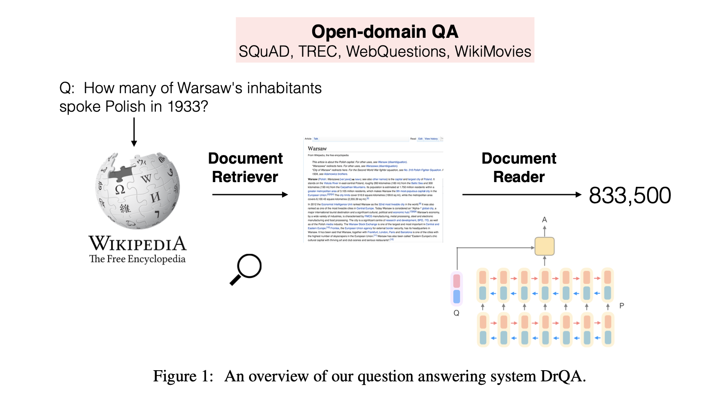
Example of a neural system
[Chen et al. (2017), Lee et al. 2019]
Simplified framework!
Notes:
Nice!

Slide 11
Benefits & drawbacks
DrQA (Dr. Question Answering)
(+) First application of NN (=LSTMs) to QA
(-) Retriever is not learned (tf-idf, bigrams)
(-) Modeled a reading comprehension task using P/Q/A pairs
ORQA (Open Retrieval Question Answering)
(+) Used a dense retriever (=BERT)
(-) Expensive pre-training objective to address retrieval; Q/A pairs now
Notes:
True open domain => Experiments show that learning to retrieve is crucial when the questions reflect an information need, i.e. the question writers do not already know the answer.
Interesting note: exploiting the web/large collection of docs increases chances of the answer being retrieved because the question is more likely to be in multiple docs. This is redundancy and may limit the amount of NLP during preprocessing

Slide 12
This paper
We still want dense representations but should use efficient training methods!
Continues the shift to using large data resources, minimal preprocessing, and focuses on minimal training using sampling
The paper is really a sum of the best parts of previous work (seriously)
Notes:
Additional point: Verifies that higher precision on the proxy metric (retrieval) translates to higher end-to-end accuracy

Slide 13
DPR Architecture
The dual-encoder architecture is the backbone of DPR. These two encoders are based on BERT but trained on different purposes.
The first one is called the Query Encoder(E_{Q}). It takes a question and maps it into a dense vector representation in a high-dimensional space.
The other one is called the Passage Encoder(E_{P}). It takes a passage or a chunk of text from the corpus and maps it into a dense vector representation.
The similarity score determines how relevant a passage is to the given question. The higher the similarity score the better the match.
Similarity(q,p)=E_{Q}​(q)⊤E_{P}​(p)
Notes:
Now we will understand the model architecture and training details
DPR employs a dual-encoder BERT based architecture. It has three components
First one is called the Query encoder which maps an input question to a 768 dimensional vector space otherwise called vector embedding
Secondly, it has a Passage encoder that maps a passage or a chunk of text from the corpus to a 768 dimensional vector space.
Then a similarity calculation step that performs the dot-product of query and passage embeddings. It shows how relevant a passage is to the input question or in other words how well the passage is oriented towards a question

Slide 14
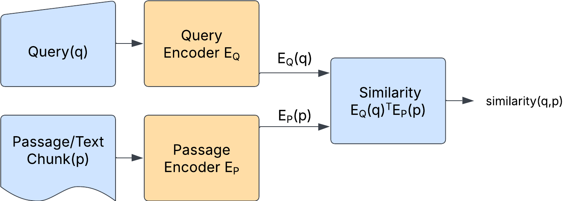
Overview and Advantages of DPR Architecture
Independent Encoders: The query and passage encoders are independent, allowing them to specialize in encoding questions and passages respectively.
Shared Vector Space: Both encoders map their inputs into the same vector space, enabling direct comparison using dot product.
Notes:
The diagram here illustrates the architecture in a simple manner.
Quickly explain the diagram
There are two main advantages of the this architecture
Firstly, the DPR architecture has two independent encoders:passage and query encoders that specialize in capturing the context in questions and passages separately. This allows the encoders to focus completely on understanding the patterns in questions and passages separately.
Secondly, since both the encoders project the input text to vector space of same dimensionality, this allows direct comparison using dot product.

Slide 15
Dual-Encoder Training - Dataset
Each training example consists of a question, a positive passage and negative passages.
Question (q) is the query to which we want an answer
A positive passage (p⁺) is the passage with the correct answer to the question.
Negative passages (p_{j}⁻) are the ones that are irrelevant to the question.
The dual-encoder is trained to maximize the similarity between a question and its corresponding positive passage while minimizing the similarity with negative passages.
Notes:
Like any supervised learning model, to train train DPR we need a dataset, loss function and an optimization algorithm.
A training example consists of a question, a +ve passage and a -ve passage
Question is the query to which we want an answer
Positive passage is the passage with the correct answer to the question whereas negative passages are the ones that are irrelevant to the question.
Note that a particular training example has a single positive passage but many negative passages
The objective of training this model is to not only maximize the similarity between a question and its corresponding positive passage but also to minimize the similarity with the negative passages.

Slide 16
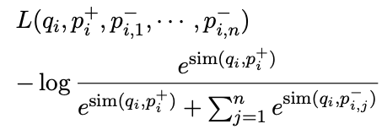
Dual-Encoder Training - Loss Function
The negative log-likelihood loss is used to train the encoders with the goal of maximizing the similarity between the question and the positive passage while minimizing the similarity with negative passages.
The denominator considers the similarity scores of both the positive and negative, ensuring the model learns to distinguish between them. Parameters are updated using gradient descent.
Notes:
Now coming to the loss function
Since we want to maximize the similarity between the question and positive passage while minimizing the similarity with the negative passages, negative log-likelihood loss is apt for this task.
It can be clearly seen that when the similarity with positive passages is high the value of the loss function is low. So the objective here is to minimize the negative-log likelihood function.
The denominator includes all negative passage similarities, so reducing the loss pushes the model to distinguish positives from negatives effectively.
The weights are updates using gradient descent optimization technique

Slide 17
Dual-Encoder Training - Selecting Negatives
We need an efficient way to pick negative passages from a large pool since, all the passages that do not contain the relevant answer are negatives.
The authors explored three different ways to pick negative passages:
Random: any random passage from the corpus
BM25: top passages returned by BM25 which doesn’t contain the answer but match most question tokens
Gold: positive passages paired with the other questions which appear in the training set.
The best model has gold passages from the same mini-batch and one/two BM25 negative passage.
Notes:
It is obvious that a given query has many negative passages since these are the passages that are irrelevant to the question. So, there has to be some intelligent way of choosing the negative passages without compromising computational efficiency.
The authors explored three different ways to select negatives: first one is randomly select passages from corpus, second one is select top passages returned by BM25 which doesn’t contain the answer but match most question tokens. The third method or the gold method is to pick positive passages paired with other questions.
The model with the best performance has gold negatives from the same minibatch along with one or two BM25 negatives

Slide 18
Dual-Encoder Training - In-batch negatives
For efficient computation, the negative passages are chosen from the same mini-batch in which the question is present called in-batch negatives.
A mini-batch of size B has B training examples/instances. Using the in-batch method each question has B-1 irrelevant or negative passages.
In-batch negatives method is effective since it boosts the number of training examples especially in learning a dual-encoder architecture.
Notes:
For efficient computation, the negative passages are chosen from the same mini-batch in which the question is present. These are called in-batch negatives.
Let say we have a mini-batch of size B. This implies we have B training example. Using the in-batch method each question in the mini-batch has B-1 negative passages or gold negatives.
This method is effective especially in learning a dual-encoder problem since it boosts the number of training examples, allowing the model to see more number of negatives/irrelevant passages thereby distinguishing positives from negatives effectively.

Slide 19
DPR Inference
The inference system in DPR has mainly three parts:
Precomputing Passage Embeddings
Query Encoding
Retrieval
Precomputing Passage Embeddings: Before answering any questions, the passage encoder(E_{P}) computes dense embeddings for all the passages in the corpus, stores and indexes them. FAISS was used to build the index of these dense embeddings
Notes:
So, The question is What is the DPR Inference, and How it actually works. During inference the aim is to retrieve the most relevant passages for a given input question. It has Three part like precomputing passage embeddings, Query Encoding and Retrieval. In the precomputing passage embeddings compute dense embeddings for all the passages in the corpus, and store it. With the help by facebook AI similarity score it used to index of these dense embeddings.

Slide 20
DPR Inference
Query Encoding: The query encoder(E_{Q}) computes the dense embedding of the input question in real-time.
Retrieval: Top k passages with the highest similarity scores are retrieved by comparing the query embedding with the precomputed passage embeddings.
The retrieval is extremely fast because the similarity score involves only inner product computation.
Notes:
Than, Query Encoding worked on real time by computing the dense embedding of the question. Finally, Retrieval, compare the query embedding with precomputed passage embedding and retrieve the Top k passages with highest similarity scores. As it involves only inner product so this is so fast to retrieval.

Slide 21
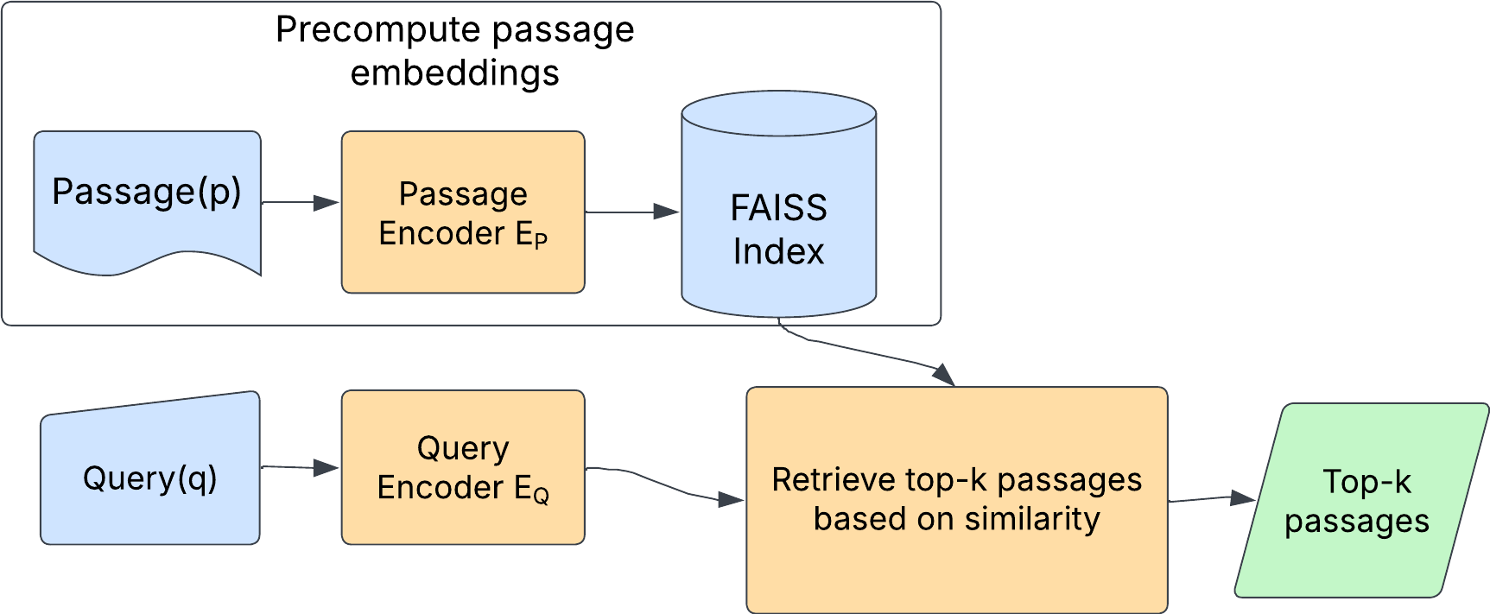
DPR Inference - Overview

Slide 22
Inference Efficiency
DPR avoids the need to encode passages repeatedly during inference by precomputing and indexing passage embeddings
The use of FAISS enables efficient similarity search, even in high-dimensional spaces.
The independent nature of the query and passage encoders allows for parallel processing, improving efficiency.
Notes:
Those are the reasons of inference efficiency, As DPR is used here, so it precomputing and indexing passage embeddings, as a result it no need repeatedly encoded the passages. And things is that, As it used Facebook AI Similarity Search which help for similarity search efficiently even in high-dimensional spaces. It does parallel processing as the query and passage encoder has independent nature.

Slide 23
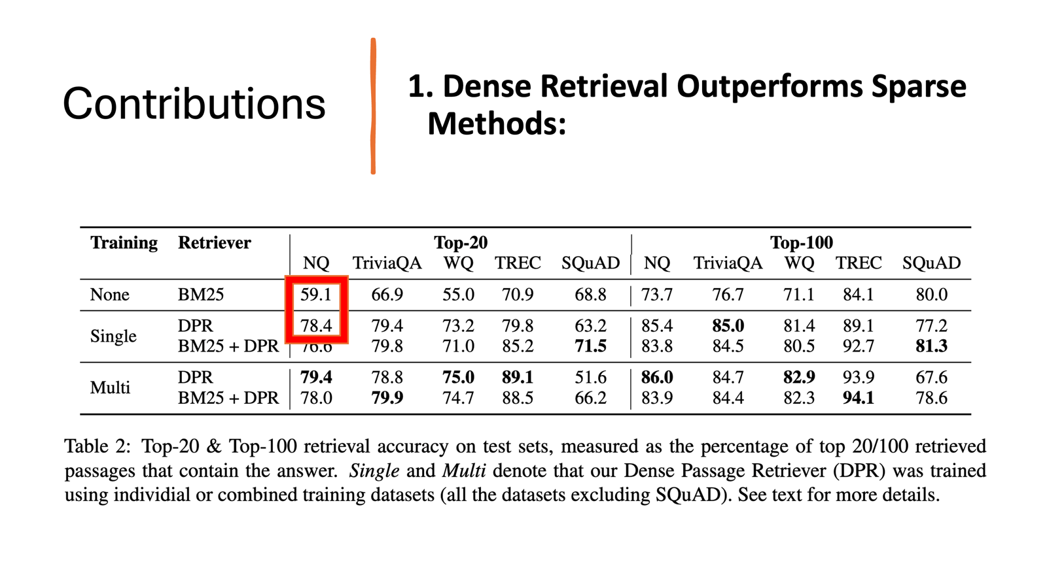
Notes:
The paper shows that dense retrieval can outperform traditional sparse methods like BM25. For example, DPR achieves 78.4% top-20 accuracy on Natural Questions, compared to 59.1% for BM25. this model also perform good for other datasets as well like for Trivia QA 79.9% in Top-20 and achieved 85% for Top 100.

Slide 24
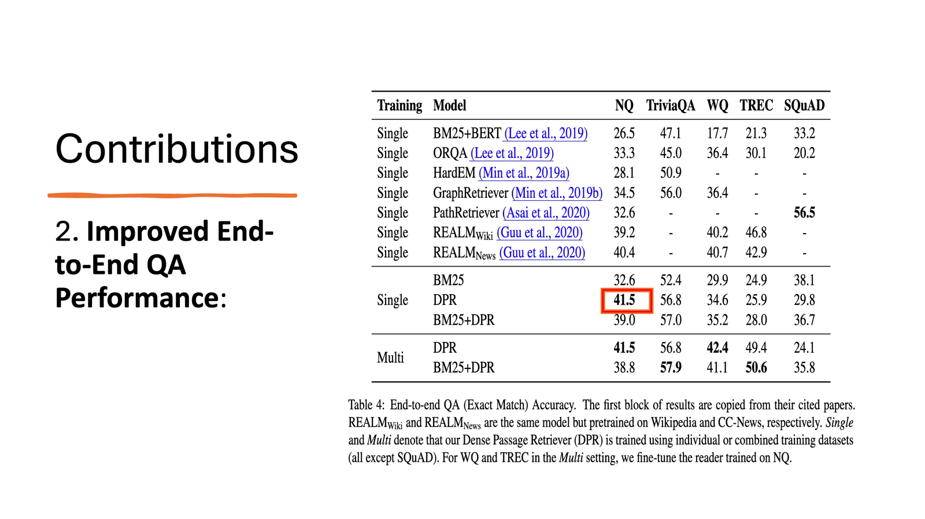
Notes:
By improving retrieval, the end-to-end question answering system also improves. For instance, DPR helps achieve 41.5% exact match accuracy on Natural Questions, beating previous methods like ORQA (33.3%), BM25+ BERT only 26.5%.

Slide 25
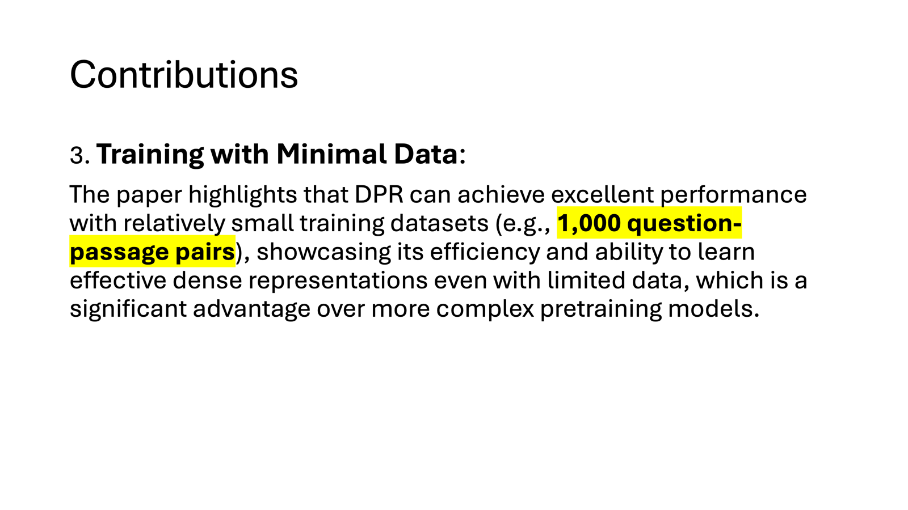

Slide 26
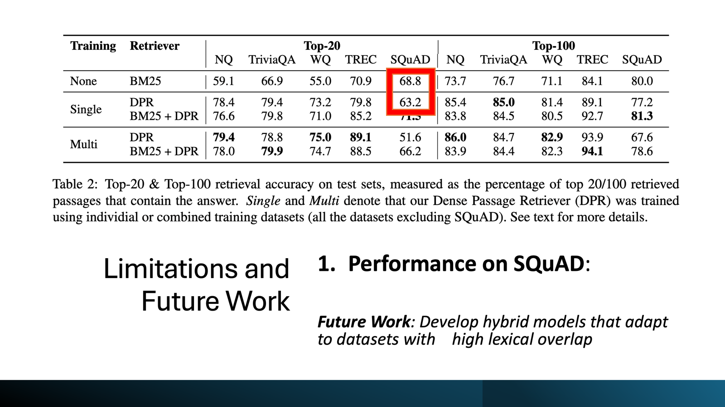
Notes:
While we can see that DPR performs very well across the board, 10-20 percentage point higher than keyword-based BM25, there is one notable exception. This exception is the SQuAD dataset, highlighted in the table on the screen. The authors of the paper note that many questions in the dataset lack context, which affect the performance of DPR, but BM25 still performs better. This is one of the limitations of DPR.

Slide 27
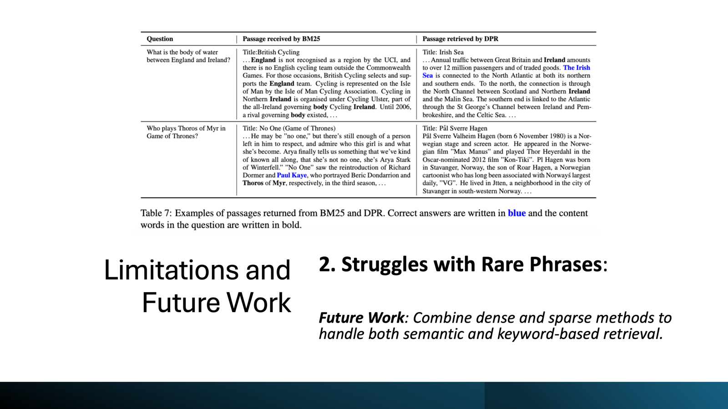
Notes:
One other limitation is that DPR seems to struggle a bit with rare phrases. On the screen we can look at one example of DPR making a mistake and at one example of an older keyword-based BM25 making a mistake. I’ll quote directly from the paper to explain this example: In the first example, the top scoring passage from BM25 is irrelevant, even though keywords such as England and Ireland appear multiple times. In comparison, DPR is able to return the correct answer, presumably by matching “body of water” with semantic neighbors such as sea and channel, even though no lexical overlap exists. The second example is one where BM25 does better. The salient phrase “Thoros of Myr” is critical, and DPR is unable to capture it.

Slide 28
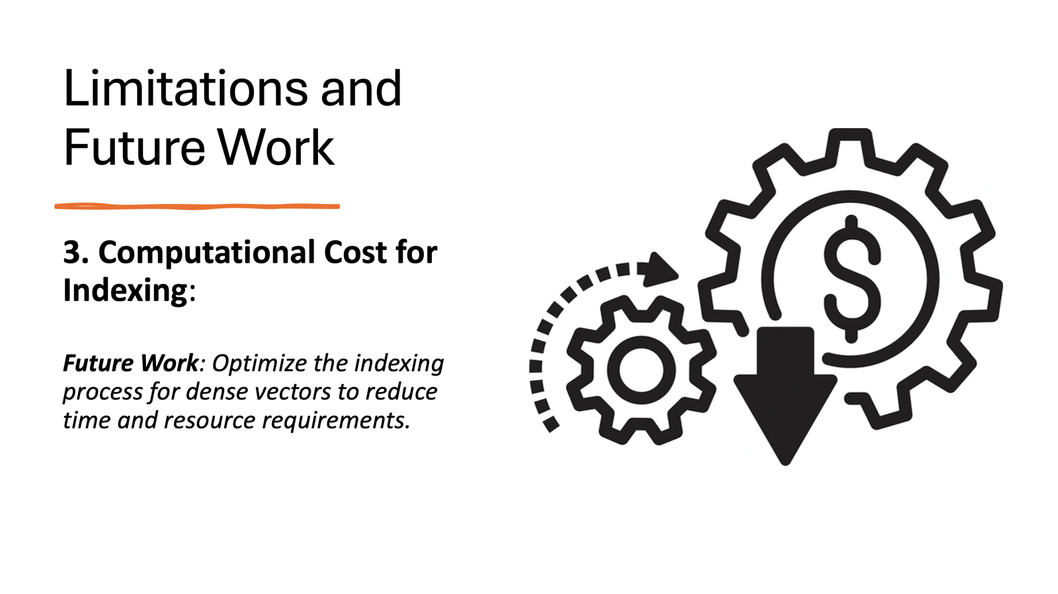
Notes:
DPR doesn’t require a lot of resources, but it is still a significant amount, which is a limitation because it makes implementation very hard on any consumer-grade computer. In the paper they mention that "Computing dense embeddings on 21-million passages is resource intensive, but can be easily parallelized, taking roughly 8.8 hours on 8 GPUs." Idea: remove the retriever altogether. Use something like T5 instead. See that paper for more info

Slide 29
Key Assumptions
✅ Dense Embeddings > Sparse Methods
"Dense retrieval methods have never been shown to outperform TF-IDF/BM25 for open-domain QA before 2019"
✅ Dual-Encoder Model Works for Retrieval
BERT-based encoders can independently learn effective passage and query representations.
✅ Fine Tuning is Sufficient
"With the proper training setup, simply fine-tuning the question and passage encoders on existing question-passage pairs is sufficient to greatly outperform BM25"
Notes:
One of the key assumptions the paper makes is that dense representations can be superior to sparse representations. This may seem obvious now, but it was not at the moment. I’ll quote the paper directly here: "Dense retrieval methods have never been shown to outperform TF-IDF/BM25 for open-domain QA before 2019".
Another assumption the paper made was that dual-encoder architecture could work better. Again, the dual encoder architecture uses two different encoders to encode questions and passages, then computes the similarity scores between the two representations. And the benchmark results show that this approach yields good results.
Another assumption I want to mention is that fine-tuning is sufficient. I’ll QUOTE from the paper: "With the proper training setup, simply fine-tuning the question and passage encoders on existing question-passage pairs is sufficient to greatly outperform BM25"

Slide 30
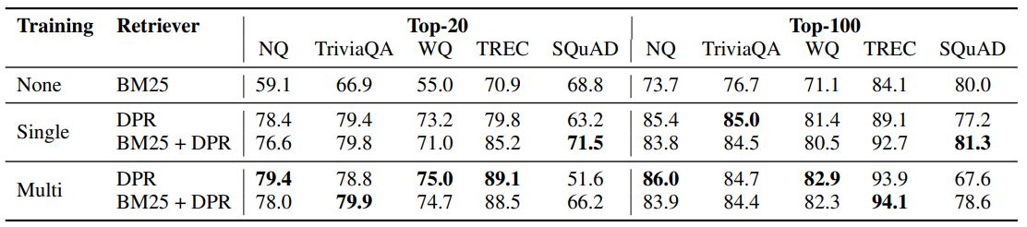
Key Assumptions
✅ In-Batch Negatives Improve Retrieval
Hard negatives (e.g., BM25-selected) enhance ranking quality.
✅ Cross-Dataset Generalization Works
A retriever trained on one dataset can transfer knowledge to others.
Notes:
In-batch negatives are one of the key parts of the paper. DPR uses a large number of passages of equal length. For any given question, one of the passages is the answer, the rest are negatives by default. Instead of using random negative, one of the innovations in this paper is using in-batch negatives. These are negatives that are a positive answer to a different question, instead of using a random passage that may not be an answer to any question. This saves resources and improves performance. This paper also shows that training DPR on all possible benchmarks improves the performance. We can see it in the table. The Single row contains figures for DPR trained only on that particular dataset, while the multi row contains performance numbers for DPR trained on all datasets at once.

Slide 31
Alternative applications
⚖️ Legal & Financial Document Search
Retrieve relevant case law, contracts, or reports based on queries.
💊 Medical & Scientific Literature Retrieval
Find research papers, clinical guidelines, or patient case studies efficiently.
💼 Enterprise Knowledge Management
Enhance internal search systems for company documents, manuals, and FAQs.
Notes:
Finally, I just wanted to highlight that the model described in the paper is actually useful for real-world applications. It can be implemented to search legal and financial documents, to retrieve medical and scientific literature and to create enterprise knowledge databases of any sort.

Slide 32
Thank you!

Slide 33
Internal Q’s
Q1: Does it do true open-domain? Yes. Results depends on what you index.
Q2: Implementation? Sure. Need a decent collection of docs. Pretrained reader/retrievers are available on HF
Q3: Useful? Downstream? Yes. Remember your query is given to the encoder. We are used to chatbots.
Q4: Future work? Handling temporal sentences & possibly simplifying the architecture. end-to-end learning & retriever-free architectures.
Q5: How does the reader work? The reader, which is used for finding the answer, is trained to predict the beginning and end of the span, respectively. Different parameters
Notes:
Slides to be presented: 29
Maybe remove one (or 2 max) slides and that’s about it

